Slide 1
Characterization of Demographic Inclusiveness in Human Cell Studies

Slide 2
Objective
The research objective of this proposal is to characterize the demographic inclusiveness of human cell sources for cell studies during the preliminary stages of drug development.
To accomplish the overall goal two research tasks are defined. First, query the Directory of Open Access Journals (DOAJ) to generate a set of demographic descriptors of donors who cells were utilized in peer reviewed studies. Second, utilize the data set to characterize the representation of gender and ethnicity by research topic over the span of available years.

Slide 3
What is the process to discover new drugs?
The United States Food and Drug Administration (FDA) defines a 5 step process
http://www.fda.gov/ForPatients/Approvals/Drugs/default.htm

Slide 4
Step 1 Discovery and Development
The genetic composition of the donor may alter which candidates are selected from thousands of possibilities.
A broader set of donors test the efficacy of the drug against a broader set of genetic variables.

Slide 5



US Food and Drug Administration: The Drug Development Process
http://www.fda.gov/ForPatients/Approvals/Drugs/default.htm
Step 1 Discovery and Development. Thousands of molecular compounds tested to find possible beneficial effects against any number of diseases.

Slide 6
Step 1 Discovery and Development
The genetic composition of the donor may alter which candidates are selected from thousands of possibilities.
A broader set of donors test the efficacy of the drug against a broader set of genetic variables.

Slide 7

US Food and Drug Administration: The Drug Development Process
http://www.fda.gov/ForPatients/Approvals/Drugs/default.htm
Step 1 Discovery and Development. Thousands of molecular compounds tested to find possible beneficial effects against any number of diseases.
Small number of candidates identified for further study. Analysis of how it is absorbed, distributed, metabolized, best dosage, mechanisms, method to administer, side effects, how it affects different groups of people, interaction with other treatments.

Slide 8
Step 2 Preclinical research
The donors to in vitro cell models vet the interaction of the drug against a specific target; i.e. destruction of a cancerous cell or support growth of new nerve.

Slide 9
US Food and Drug Administration: The Drug Development Process
http://www.fda.gov/ForPatients/Approvals/Drugs/default.htm
Step 1 Discovery and Development. Thousands of molecular compounds tested to find possible beneficial effects against any number of diseases.
Small number of candidates identified for further study. Analysis of how it is absorbed, distributed, metabolized, best dosage, mechanisms, method to administer, side effects, how it affects different groups of people, interaction with other treatments.
Step 2 Preclinical research. In vitro In vivo to identify dosing and toxicity in preparation for testing in people.
IN VITRO: CELL MODEL

Slide 10
Step 2 Preclinical research
The donors to in vitro cell models vet the interaction of the drug against a specific target; i.e. destruction of a cancerous cell or support growth of new nerve.
In vivo testing utilizing animal models to evaluate how the drug effects tissues and organ system throughout the organism.

Slide 11

US Food and Drug Administration: The Drug Development Process
http://www.fda.gov/ForPatients/Approvals/Drugs/default.htm
Step 1 Discovery and Development. Thousands of molecular compounds tested to find possible beneficial effects against any number of diseases.
Small number of candidates identified for further study. Analysis of how it is absorbed, distributed, metabolized, best dosage, mechanisms, method to administer, side effects, how it affects different groups of people, interaction with other treatments.
Step 2 Preclinical research. In vitro In vivo to identify dosing and toxicity in preparation for testing in people.
IN VITRO: CELL MODEL
IN VIVO: ANIMAL MODEL

Slide 12
Step 3 Clinical research.
Human subjects participate in the study. The genetic diversity represented in Step 3 is the broadest yet in the study.

Slide 13
US Food and Drug Administration: The Drug Development Process
http://www.fda.gov/ForPatients/Approvals/Drugs/default.htm
Step 1 Discovery and Development. Thousands of molecular compounds tested to find possible beneficial effects against any number of diseases.
Small number of candidates identified for further study. Analysis of how it is absorbed, distributed, metabolized, best dosage, mechanisms, method to administer, side effects, how it affects different groups of people, interaction with other treatments.
Step 2 Preclinical research. In vitro In vivo to identify dosing and toxicity in preparation for testing in people.
IN VITRO: CELL MODEL
IN VIVO: ANIMAL MODEL
Step 3 Clinical research.
Phase 1: 20-100 healthy volunteers or people with the disease/condition surveyed over several months. 70% pass rate
Phase 2: Up to several hundred people with the disease/condition surveyed for months up to 2 years. 33% pass rate
Phase 3: 300-3000 volunteers with the disease/condition surveyed 1-4 years to detect adverse reactions. 25-30% pass rate
Phase 4: Several thousand volunteers who have the disease/condition to assess safety and efficacy.

Slide 14
Step 4 FDA Review Step 5 FDA Post-Market Safety Monitoring

Slide 15
US Food and Drug Administration: The Drug Development Process
http://www.fda.gov/ForPatients/Approvals/Drugs/default.htm
Step 1 Discovery and Development. Thousands of molecular compounds tested to find possible beneficial effects against any number of diseases.
Small number of candidates identified for further study. Analysis of how it is absorbed, distributed, metabolized, best dosage, mechanisms, method to administer, side effects, how it affects different groups of people, interaction with other treatments.
Step 2 Preclinical research. In vitro In vivo to identify dosing and toxicity in preparation for testing in people.
IN VITRO: CELL MODEL
IN VIVO: ANIMAL MODEL
Step 3 Clinical research.
Phase 1: 20-100 healthy volunteers or people with the disease/condition surveyed over several months. 70% pass rate
Phase 2: Up to several hundred people with the disease/condition surveyed for months up to 2 years. 33% pass rate
Phase 3: 300-3000 volunteers with the disease/condition surveyed 1-4 years to detect adverse reactions. 25-30% pass rate
Phase 4: Several thousand volunteers who have the disease/condition to assess safety and efficacy.
Step 4 FDA Review
Step 5 FDA Post-Market Safety Monitoring

Slide 16
Why does the FDA require racial diversity during clinical research?
Including racial diversity is assumed to expanding the genetic diversity represented in the study.

Slide 17
ASSUMPTION: WITHIN RACES GENETICS ARE WELL CLUSTERED. GENETIC VARIATION IN TESTING COMES FROM SAMPLIG MULTIPLE RACES
RACE A
RACE B
RACE C
RACE D

Slide 18
Does racial diversity in a study mean genetic diversity?
No, there is no scientific basis for genetic diversity along racial groups.
This is the argument presented in the AAAS Science paper.
Race present greater genetic diversity within classifications than between them.

Slide 19
ASSUMPTION: WITHIN RACES GENETICS ARE WELL CLUSTERED. GENETIC VARIATION IN TESTING COMES FROM SAMPLIG MULTIPLE RACES
RACE A
RACE B
RACE C
RACE D
REALITY: GREATER GENETIC VARIATION EXISTS WITHIN GROUPS THAN BETWEEN
RACE A
RACE B
RACE C
RACE D

Slide 20
Why is it relevant to characterize racial bias in cell models if race is not indicative of genetic diversity?
Legacy: It is a legacy system which many people have abided by and seen value in for decades: Federal law required racial representation.
Formative for new understanding: A retrospective survey of how race has informed cell models and therefore drug development enable data-driven conversations about the role race has played in drug development.
Expose inefficiencies: Such a retrospective may provide context for understanding existing inefficiencies in drug development.

Slide 21
Who are the donors to cell studies for drug development?
Identify race, gender and age of donors to cell model studies.
Query databases of published articles to scrape specifications.
Assess the value of the publication by including the number of citations or funding acknowledgements.
Databases
Google Scholar
Directory of Open Access Journals

Slide 22
1. Query database (Google Scholar, Directory of Open Access Journals) for articles with term: Human AND Cell
2. Scan each article for heading in italics, bold or space before: Materials and methods OR Methods OR Experimental procedure
Database article title, keyword, publication year, number of times cited. Parse the 500 characters surrounding “cell” for cell type, supplier, gender, race, ethnicity
3. Scan 1000 characters after heading for the word “cell”
IF ANY TERM IS FOUND
4. If “cell” is found: Scan 500 characters before and after for one of the following terms:
Cell supplier:
American Type Culture Collection
ATTC
Coriell
Cell Applications
Lonza
Age
Aged
Age
years
Gender:
Male
Female
Ethnicity:
Hispanic
Latino
Race:
African American
American Indian
Alaska Native
Alaskan Native
Asian
Black
Native Hawaiian
Native Hawaii
Pacific Islander
White
Caucasian
IF NO TERM IS FOUND
Query next article

Slide 23
Query database (PLoS, Google Scholar, Directory of Open Access Journals)
1. Scan within the article’s headings for Materials and methods OR Methods OR Experimental procedure for cell supplying company
Database article title, keyword, publication year, number of times cited. Parse the 500 characters surrounding “cell” for cell type, supplier, gender, race, ethnicity
American Type Culture Collection OR ATTC OR Coriell OR Cell Applications OR Lonza
IF ANY TERM IS FOUND
2. Scan 500 characters before/after company for “human”
3. If “human” is found: Scan for the following, if found populate into a database under the requisite heading:
IF NO TERM IS FOUND
Age
Aged
Age
years
Gender:
Male
Female
Ethnicity:
Hispanic
Latino
Race:
African American
American Indian
Alaska Native
Alaskan Native
Asian
Black
Native Hawaiian
Native Hawaii
Pacific Islander
White
Caucasian
Query next article

Slide 24
1.Query database
PLoS
Google Scholar,
Directory of Open Access Journals
2. Scan for article heading
Materials and methods
Methods
Experimental
3. Scan within the heading for company names which supply cells
4. Scan within 500 characters of the company name for the word “human”
5. If “human” is found: Scan for the following, if found populate into a database under the requisite heading:
6. Database article title, keyword, publication year, number of times cited.
American Type Culture Collection
ATCC
Coriell
Cell Applications
Lonza
Gender:
Male, Female
Ethnicity:
Hispanic, Latino
Race:
African American, American Indian, Alaska Native, Alaskan Native, Asian, Black, Caucasian, Native Hawaiian, Pacific Islander, White,

Slide 25
What would a figure look like to characterize donors to cell studies?
Manually collected database of donor specifications
https://docs.google.com/spreadsheets/d/1-LcZn_nezPI1lGD5M2ZHFd4KaQLuv0nejOeYssWmS1w/edit

Slide 26
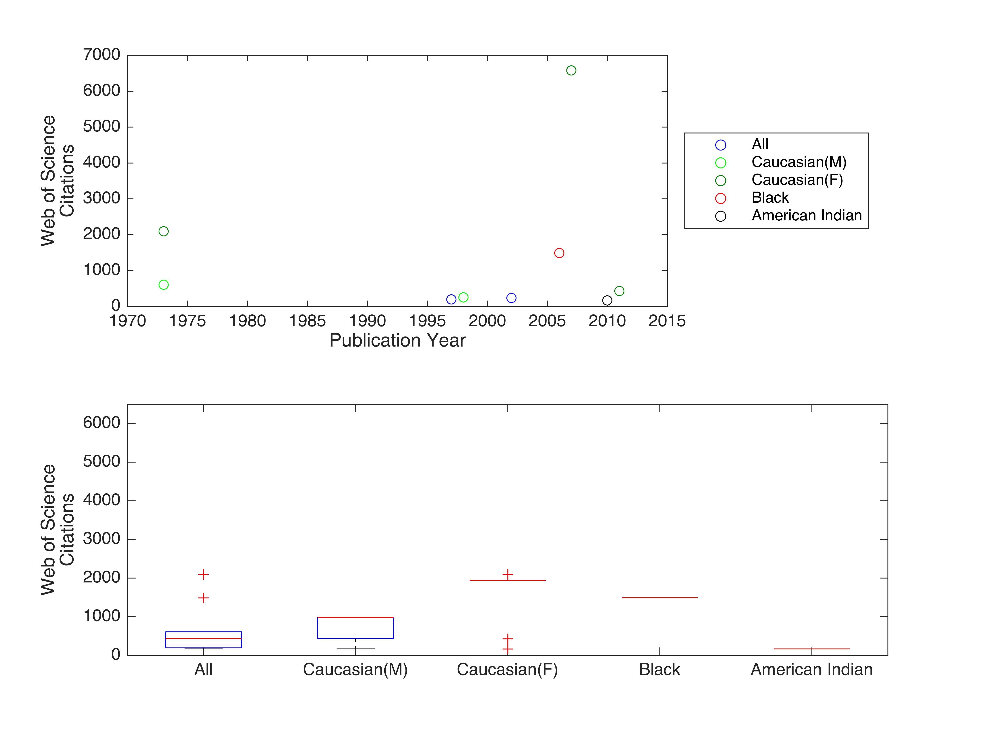
Representation of donor to cell studies in published literature

